Slide 1



Data Insights for New Movie Studio
Ruthy Yao
May 2024

Slide 2


Summary
This project takes the description analysis to give Microsoft the insights on the most successful genres, the best release month and the budget required to run a studio.
1
2
3
The studio should focus on a mix of Animation, Sci-fi and Adventure.
The best months to release a movie are May, July and November.
The studio needs to prepare a budget of $550-$700m a year.

Slide 3


Outline
Business Problem
1
Data and Method
2
Data Insights
3
Conclusions
4

Slide 4

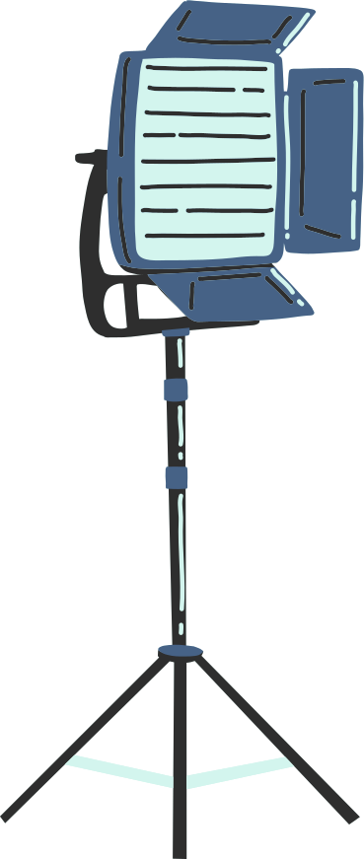

Business Problem
New to the movie production market with no prior industry knowledge on what the most popular genres are.
Limited understanding on how much production budget is required to run a studio.
To choose the right month to release movie to maximize the gross revenue performance.

Slide 5

Data and Methods
• Collated from four well-known movie database – IMDB, The Numbers, The Movie DataBase and the Box Office Mojo
• Consolidated dataframe contains over 2000 movies that were released between 2010 and 2018.
• Apply the descriptive analysis to examine the key features such as popularity score, gross revenue, budget, profit and month of release.

Slide 6
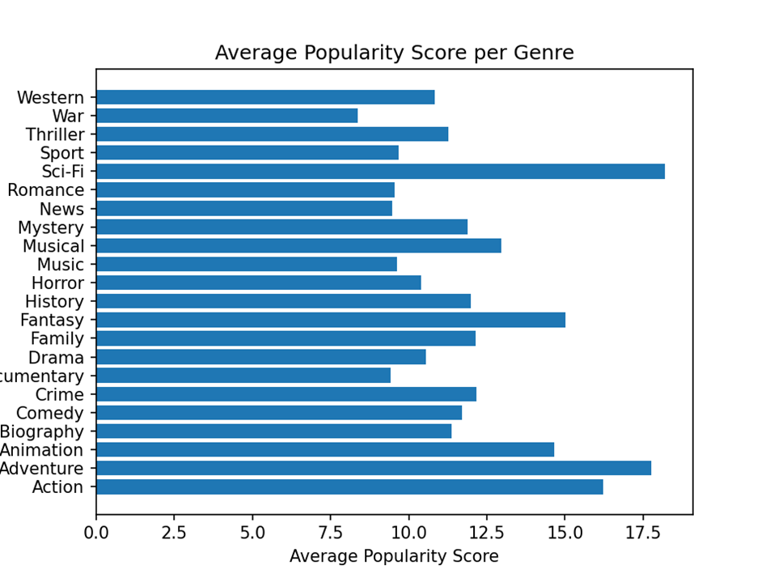
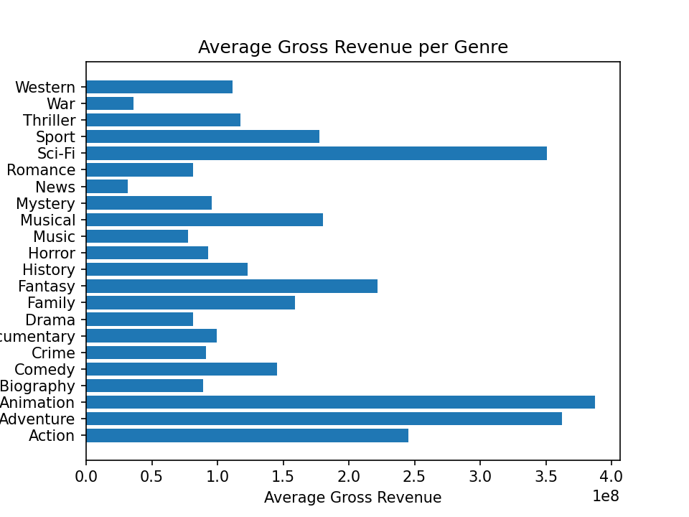

Insight I – Animation, Sci-fi and Adventure are the best genres to choose
Sci-fi, Animation and Adventures top the popularity score as well as the worldwide gross revenue performance.

Slide 7

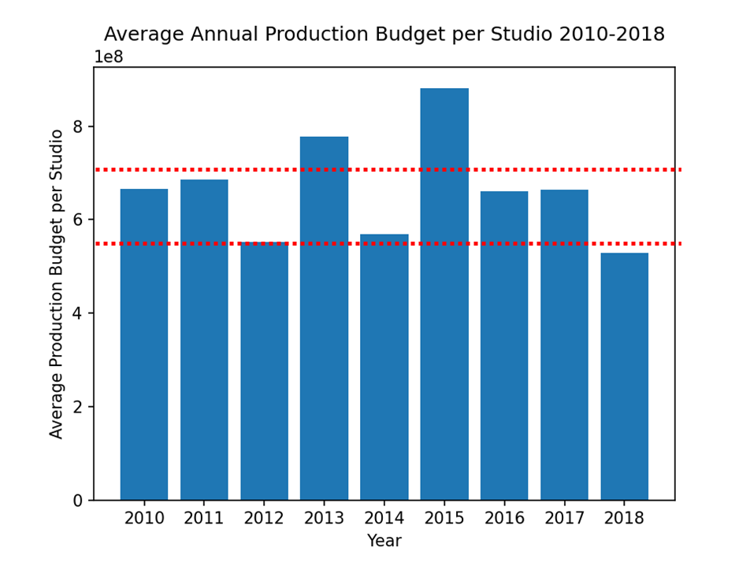
Insight II – Annual Production Budget of $550m-$700m is required to run a studio
• The data looked into 12 studios globally of their annual production budget for nine years from 2010 to 2018.
• An annual budget of $550m-$700m is required to run a studio.

Slide 8

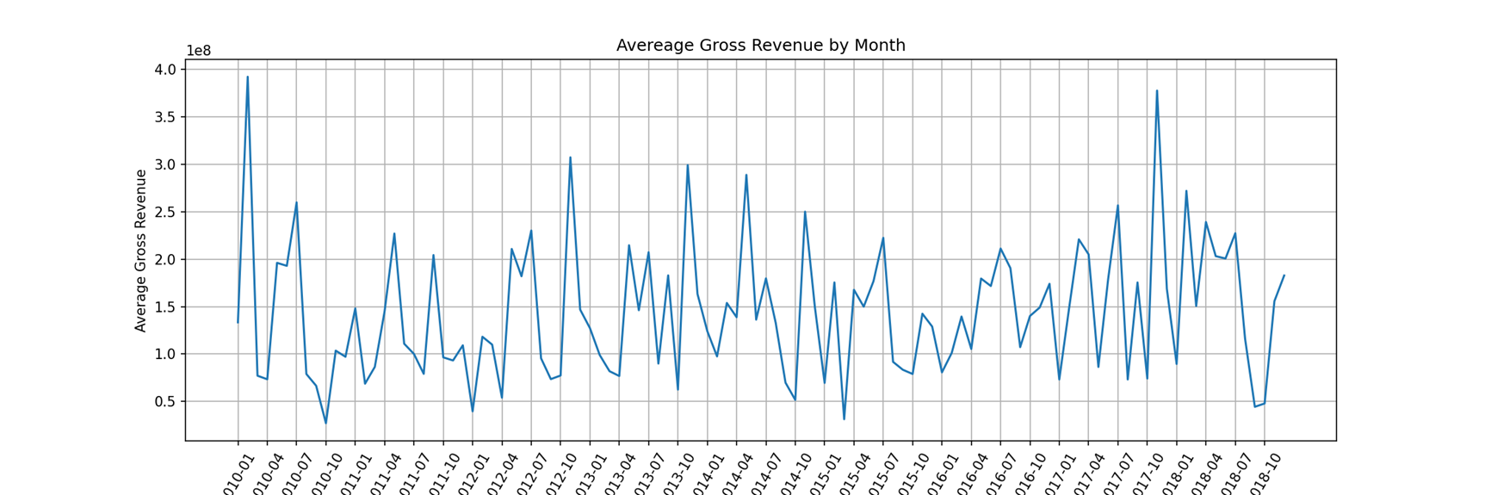
Insight III – May, July and November are the best months to release movie
Gross revenue peaks in May, July and November, potentially driven by school holidays as well as the entry eligibility requirement of the Academy Awards.

Slide 9

Conclusions
• Microsoft should focus on producing a mixed genres of Animation, Sci-fi and Adventure.
• Microsoft should be prepared to allocate $550m to $700k funding to the new studio.
• Microsoft can plan the release of the movies in either May/July – the school holiday season or November for entry of Academy Awards.

Slide 10

Thank you!
Email : zejia.yao@gmail.com
GitHub: https://github.com/RuthyYao

